Slide 1

SHRI VISHNU ENGINEERING COLLEGE FOR WOMEN :: BHIMAVARAM (AUTONOMOUS)
Analysis Of Chronic Kidney Disease Using
Machine Learning Techniques
Team Members :
20B01A0448 – G.N.S.Lakshmi
20B01A0446 – G.Pooja Hitha
20B01A0424 – Ch.Tejaswini
20B01A0451 – G.Akshitha
Batch Number : 11
Project Guide :
Mr. D. Murali Krishna
Sr. Assistant Professor
Mrs. T. Pavani
Assosiate Professor
DEPARTMENT OF ELECTRONICS AND COMMUNICATION ENGINEERING

Slide 2
MOTIVATION:
Chronic Kidney Disease (CKD) is an important cause of morbidity and morality worldwide. It stands in 12th place in India for its mortality rate and in 3rd place worldwide.
Machine learning models can analyze patient data to detect CKD at an early stage when symptoms may be subtle. This early intervention can significantly improve the quality of life for patients.
CKD treatment can be expensive, especially in advanced stages. Machine learning can help in cost-effective screening and management by reducing unnecessary tests and hospitalizations.
Timely diagnosis and intervention can slow down the progression of CKD and reduce mortality rates. Machine learning plays a pivotal role in identifying high-risk patients.
3

Slide 3
OBJECTIVE:
To preprocess the selected dataset.
To design, develop, and train machine learning models using CKD datasets for the detection of Chronic Kidney Disease.
To conduct a comparative analysis of the performance metrics (such as accuracy, sensitivity, selectivity, precision, and F1-score) for machine learning models in the detection of Chronic Kidney Disease.
To analyze the importance of feature engineering and the use of feature ranking algorithms in identifying the effective features for detection of CKD.
4

Slide 4
BACKGROUND:
The main function of kidney is to filter the blood for urine formation and remove wastes and extra fluid from our body. Kidney also removes acid that is produced by the cells in our body to maintain good health.
Glomerular Filtration Rate (GFR): GFR is a critical measure of kidney function. It quantifies the amount of blood that is filtered by the glomeruli per minute. A decrease in GFR is a hallmark of CKD.
Biomarkers: These are measurable indicators in the blood or urine that can signal kidney damage or dysfunction, such as serum creatinine and albuminuria.
Risk Factors: Various factors, including hypertension, diabetes, family history, and age, contribute to the development of CKD.
Stages of CKD: CKD is classified into stages based on GFR, with Stage 1 being the mildest and Stage 5 representing end-stage kidney disease (ESKD) requiring dialysis (or) transplantation.
5

Slide 5
BACKGROUND (Contd.,):
Glomerulus: The glomerulus is a tiny cluster of blood vessels within the kidney that plays a crucial role in blood filtration and urine formation.
Serum Creatinine: Serum creatinine is a waste product of muscle metabolism that can indicate impaired kidney function when elevated in the blood.
Albuminuria: Albuminuria refers to the presence of the protein albumin in the urine, which can be a sign of kidney damage.
Machine Learning in CKD to produce personalized treatment recommendations. These encompass a range of methods including KNN, Decision Trees, and Naive Bayes to train models that can predict CKD risk, progression, and treatment outcomes based on input data.
The K-Nearest Neighbors Algorithm known as KNN, is a non-parametric, supervised learning classifier, which uses proximity to make classifications or predictions about the grouping of an individual data point.
A decision tree is a type of supervised machine learning used to categorize or make predictions based on how a previous set of questions was answered.
The Naïve Bayes classifier is a supervised machine learning algorithm, which is used for classification tasks, like text classification. It is also part of a family of generative learning algorithms, meaning that it seeks to model the distribution of inputs of a given class or category.
6

Slide 6
LITERATURE SURVEY:
Authors | Title | Findings
Dibaba Adeba Debal and Tilahun Melak Sitote | Chronic Kidney Disease Prediction Using Machine Learning Techniques | XGBoost - 82.6% Decision Tree - 77.5% Random Forest - 78.3% SVM - 78.78%
K.R.Anantha Padmanaban and G.Parthiban | Applying Machine Learning Techniques For Predicting The Risk Of Chronic Kidney Disease | Naïve Bayes - 86% Decision Tree - 91%
Saurabh Pal | Chronic Kidney Disease Prediction Using Machine Learning Techniques | Decision Tree - 95.92%
8

Slide 7
LITERATURE SURVEY:
Authors | Title | Findings
Sathiya Priya S and Suresh Kumar M | Chronic Kidney Disease Prediction Using Machine Learning | Decision Tree - 96.25% Naive Bayes - 93.75%
Dr. Vijayaprabakaran.K, Pratheek Reddy.P | Chronic Kidney Disease Diagnosis Using Machine Learning | Random Forest - 95.5% XGBoost - 94.25% Support Vector Machines - 65%
Virginia A. Dines and Vesna D. Garovic | Menopause and chronic kidney disease | CKD mostly found in women/girls compared to men/boys.
9

Slide 8
LITERATURE SURVEY:
Authors | Title | Findings
Anusorn Charleonnan, Thipwan Fufaung, Tippawan Niyomwong | Predictive Analytics for Chronic Kidney Disease Using Machine Learning Techniques | 5 fold cross validation is used for developing the model and KNN algorithm has given the highest accuracy of 93.1%
Asif Salekin, John Stankovic | Detection of Chronic Kidney Disease and Selecting Important Predictive Attributes | Important features in the dataset are Specific Gravity, Albumin, Diabetes Mellitus, Hypertension and so on
Gazi Mohammed Ifraz, Muhammad Hasnath Rashid | Comparative Analysis for Prediction of Kidney Disease Using Intelligent Machine Learning Methods | Logistic Regression and Decision Tree gives accurate results compared to Support Vector Machine (SVM)
Siddheshwar Tekale | Prediction of Chronic Kidney Disease Using Machine Learning Algorithm | SVM - 93.08% Decision Tree - 88.95%

Slide 9
PROBLEM IDENTIFICATION AND PROPOSED SOLUTION:
The aim of this project is to develop a machine learning model for symptoms-based disease prediction. The goal is to create an efficient and accurate system that can predict diseases based on a set of symptoms reported by patients.
Traditionally, diagnosing diseases has heavily relied on the expertise and experience of medical professionals. However, this process can be time-consuming and may lead to errors or delays in diagnosis. By leveraging machine learning techniques, we can automate the disease prediction process and potentially improve the accuracy and efficiency of diagnoses.
Development of chronic kidney analyzer using machine learning techniques helps to solve the above problem.
10

Slide 10
PROJECT IMPLEMENTATION DETAILS:
Data
Repository
Data Preprocessing
Cleaned Dataset
Training Data
Testing Data
KNN
Decision Tree
Naïve Bayes
Result
Performance analysis
11

Slide 11
PROJECT IMPLEMENTATION DETAILS:
Collecting the Data: Data preparation is the first step for any machine learning problem. We will be using a dataset from Kaggle for this problem. There are a total of 25 attributes in the dataset out of which 11 are numeric and 14 are nominal.
Data Preprocessing: Cleaning is the most important step in a machine learning project. The quality of our data determines the quality of our machine-learning model. So it is always necessary to preprocess the data before feeding it to the model for training. In our dataset all the columns are numerical.
Cleaned Data: After gathering and cleaning the data, the data is ready and can be used to train and test a machine learning model.
Model Building: we will develop a model such as KNN, Decision Tree, Naïve Bayes and train it with the cleaned data.
12

Slide 12
PROJECT IMPLEMENTATION DETAILS (Contd.,):
Training: Model training is the phase in the model development lifecycle where practitioners try to fit the best combination of weights and bias to a machine learning algorithm to minimize a loss function over the prediction range. 60%-80% of cleaned data is used to train the model.
Testing: Model testing is referred to as the process where the performance of a fully trained model is evaluated on a testing set. 40%-20% of the remaining cleaned data is used to test the model
Inference: After training the three models we will be analyzing CKD for the inputs by combining the analysis of all three models. This makes our overall analysis more robust and accurate.

Slide 13
Subsystems/Design/Mathematical Background of the project:
Data Collection and Preprocessing: Basic statistics (mean, median, standard deviation), data normalization, and data cleaning techniques are used to prepare the dataset.
Standardize features using z-score normalization : z=x−μ\ σ
Feature Selection/Engineering: Feature selection methods like correlation coefficients, mutual information, and Principal Component Analysis (PCA) can be used to identify relevant features.
Classification Algorithms: Utilize mathematical models for classification, such as Support Vector Machines (SVM), Decision Trees, Random Forests, or Logistic Regression. These models rely on linear algebra, probability, and optimization techniques.
Evaluation Metrics: Metrics like accuracy, precision, recall, F1-score, and ROC curves are used to evaluate the performance of the machine learning models.

Slide 14
Subsystems/Design/Mathematical Background of the project (cont’d..):
Hyperparameter Tuning: Techniques like grid search or random search involve systematically adjusting hyperparameters and evaluating model performance using mathematical optimization.
Model Interpretability: Methods like SHAP (SHapley Additive exPlanations) or LIME (Local Interpretable Model-agnostic Explanations) use mathematical concepts to explain model predictions.
Data Visualization: Creating plots, charts, and heatmaps to visualize data distribution and model outcomes using mathematical representations.
Risk Prediction Models: Developing mathematical models to predict the risk of chronic kidney disease progression, which may involve Cox proportional hazards models or logistic regression.
Probability Theory: Understanding and applying probability theory to assess the likelihood of various outcomes, especially in probabilistic machine learning models.

Slide 15

Subsystems/Design/Mathematical Background of the project (cont’d..):
In KNN, the choice of a distance metric (e.g., Euclidean distance or Manhattan distance) is crucial.
The mathematical formula for these distance metrics can be employed in the subsystem.
where x_{i​} and y_{i​} are attribute values.
The decision tree is a mathematical model used for classification. It uses concepts like Gini impurity or entropy to split the data into subsets based on different attributes.
The mathematical process of training the decision tree involves recursive partitioning of data until it reaches a stopping criterion.
The Naive Bayes algorithm involves conditional probability calculations, in the case of binary features, the probability of a feature given a class can be calculated as:
P(x_{i}​ ∣C)= P(x_{i​} ∩C)\ P(C)

Slide 16
Complete Flow chart:
Data Collection
Data Preprocessing
Model Building
Performance
Analysis
Training and Testing

Slide 17
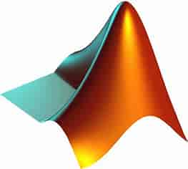
TOOLS REQUIRED:
Matlab (R2023b)
13

Slide 18
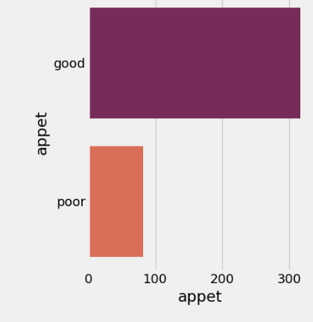
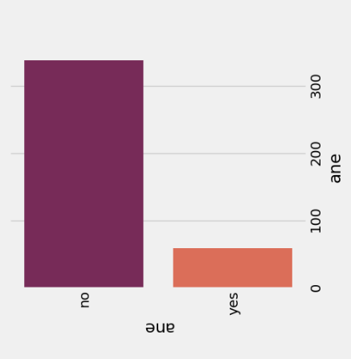
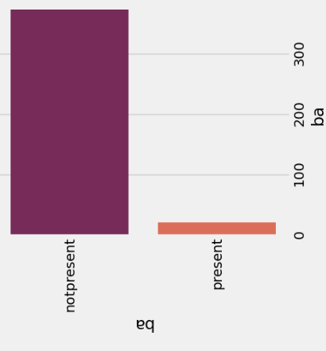
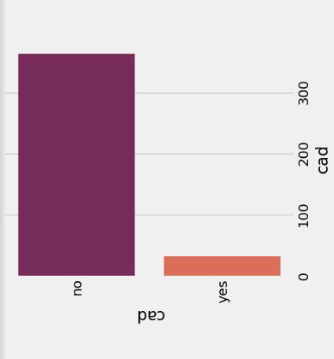
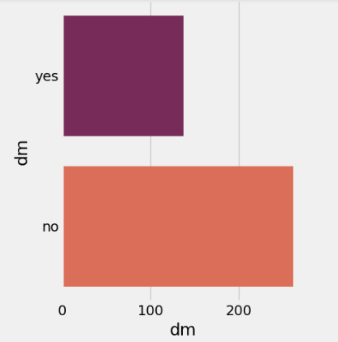
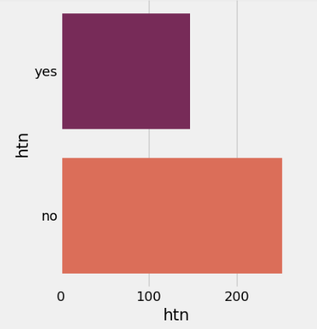
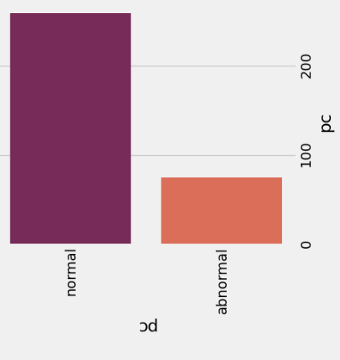
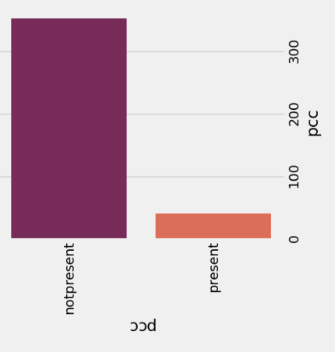
Objective-Wise Results :
CKD dataset
appet ane ba cad
dm htn pc pcc

Slide 19
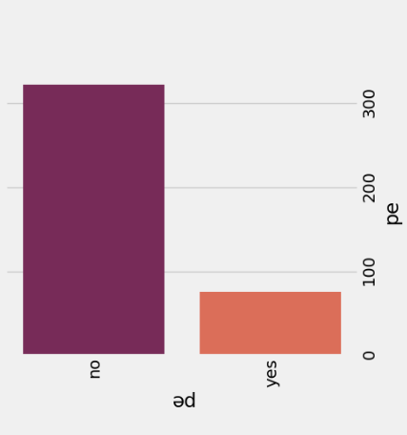
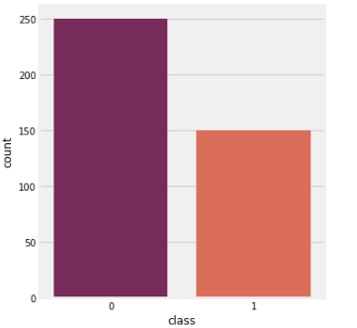
Objective-Wise Results (contd.,):
CKD dataset
pe classification

Slide 20
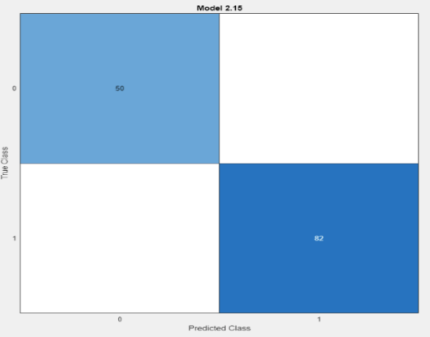
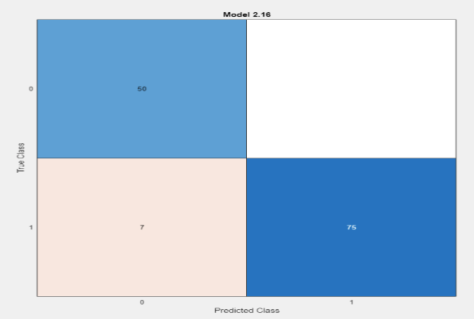
Objective-Wise Results (contd.,):
KNN result with 67:33 training and testing ratio
Fine KNN Medium KNN Coarse KNN

Slide 21
Objective-Wise Results (contd.,):
Analysis of CKD using different types of KNN under 67:33 training testing ratio
Types of KNN | Training Accuracy | Testing Accuracy | Sensitivity | Selectivity | Precision | F1- Score
Fine KNN | 98.1 | 100 | 100 | 100 | 100 | 100
Medium KNN | 93.3 | 94.7 | 87.7 | 100 | 100 | 93.4
Coarse KNN | 76.5 | 78.8 | 64.1 | 100 | 100 | 78.1

Slide 22
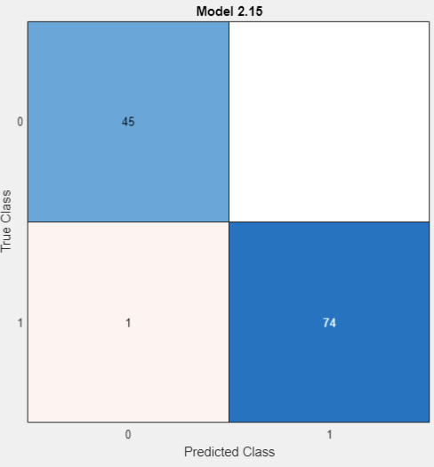
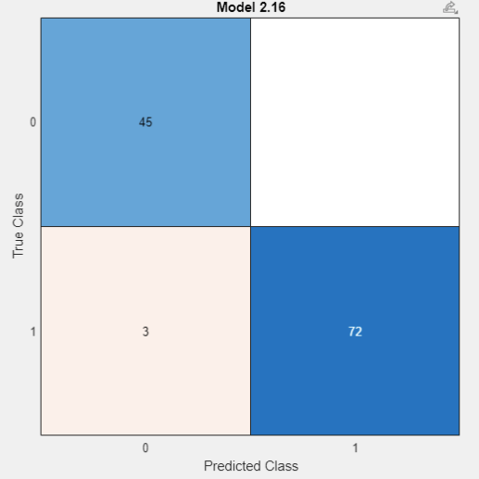
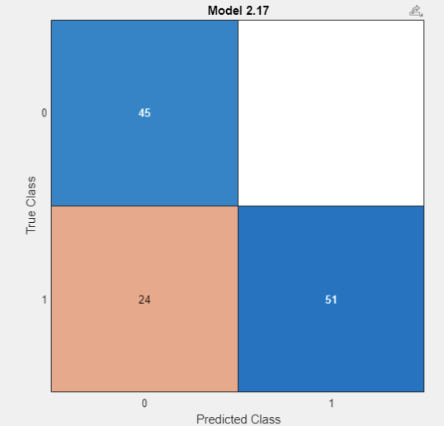
Objective-Wise Results (contd.,):
KNN result with 70:30 training and testing ratio
Fine KNN Medium KNN Coarse KNN

Slide 23
Objective-Wise Results (contd.,):
Analysis of CKD using different types of KNN under 70:30 training and testing ratio
Types of KNN | Training Accuracy | Testing Accuracy | Sensitivity | Selectivity | Precision | F1- Score
Fine KNN | 98.9 | 99.2 | 97.8 | 100 | 100 | 98.8
Medium KNN | 95 | 97.5 | 93.75 | 100 | 100 | 96.77
Coarse KNN | 78.2 | 80 | 65.2 | 100 | 100 | 78.9

Slide 24

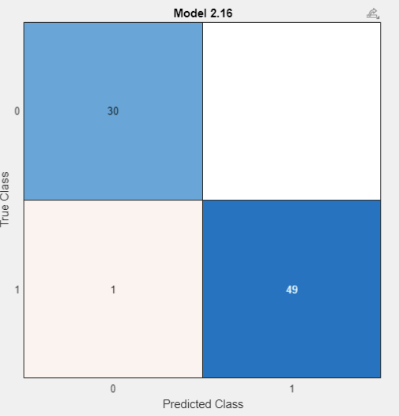
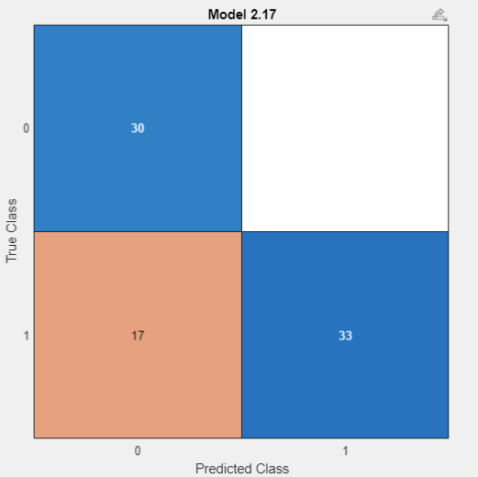
Objective-Wise Results (contd.,):
KNN result with 80:20 training and testing ratio
Fine KNN Medium KNN Coarse KNN

Slide 25
Objective-Wise Results (contd.,):
Analysis of CKD using different types of KNN under 80:20 training and testing ratio
Types of KNN | Training Accuracy | Testing Accuracy | Sensitivity | Selectivity | Precision | F1- Score
Fine KNN | 98.1 | 100 | 100 | 100 | 100 | 100
Medium KNN | 94.7 | 98.8 | 96.77 | 100 | 100 | 98.35
Coarse KNN | 79.7 | 78.8 | 63.8 | 100 | 100 | 77.89

Slide 26
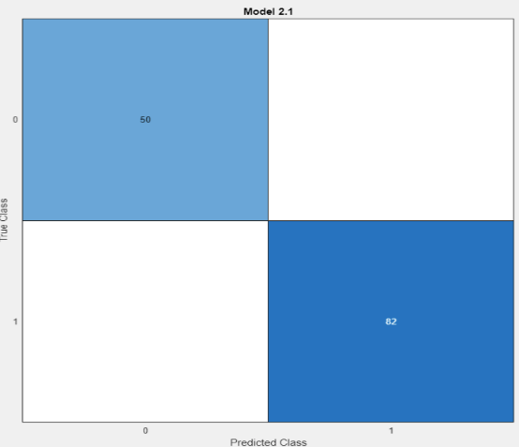
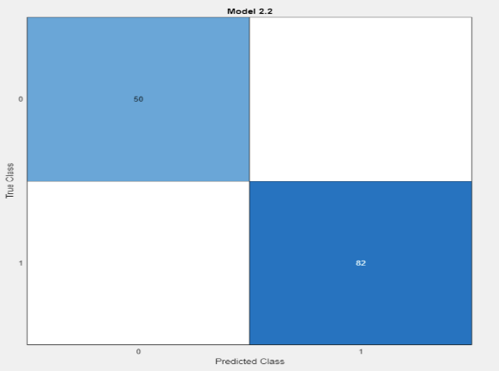
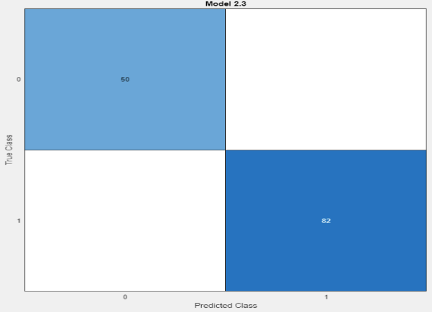
Objective-Wise Results (contd.,):
Decision Tree result with 67:33 training and testing ratio
Fine Tree Medium Tree Coarse Tree

Slide 27
Objective-Wise Results (contd.,):
Analysis of CKD using different types of DT under 67:33 training and testing ratio
Types of Tree | Training Accuracy | Testing Accuracy | Sensitivity | Selectivity | Precision | F1- Score
Fine Tree | 98.5 | 100 | 100 | 100 | 100 | 100
Medium Tree | 98.5 | 100 | 100 | 100 | 100 | 100
Coarse Tree | 98.5 | 100 | 100 | 100 | 100 | 100

Slide 28

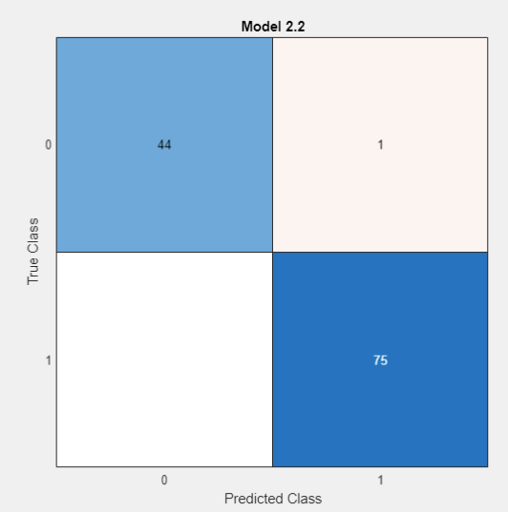
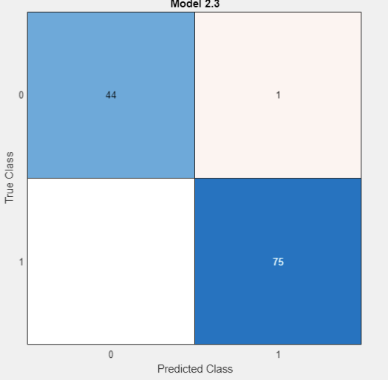
Objective-Wise Results (contd.,):
Decision Tree result with 70:30 training and testing ratio
Fine Tree Medium Tree Coarse Tree

Slide 29
Objective-Wise Results (contd.,):
Analysis of CKD using different types of DT under 70:30 training and testing ratio
Types of Tree | Training Accuracy | Testing Accuracy | Sensitivity | Selectivity | Precision | F1- Score
Fine Tree | 98.6 | 99.2 | 100 | 98.68 | 97.77 | 98.87
Medium Tree | 98.6 | 99.2 | 100 | 98.68 | 97.77 | 98.87
Coarse Tree | 98.6 | 99.2 | 100 | 98.68 | 97.77 | 98.87

Slide 30
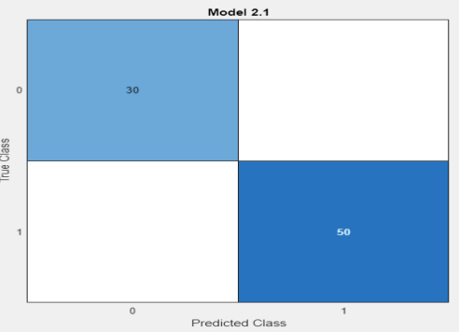
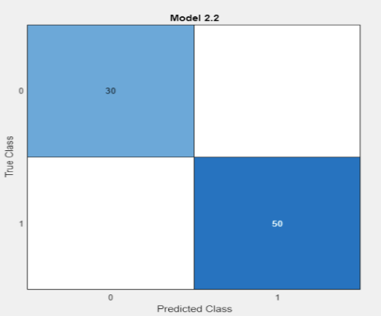
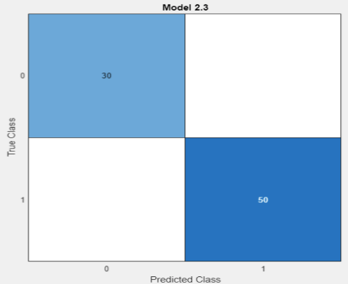
Objective-Wise Results (contd.,):
Decision Tree result with 80:20 training and testing ratio
Fine Tree Medium Tree Coarse Tree

Slide 31
Objective-Wise Results (contd.,):
Analysis of CKD using different types of DT under 80:20 training and testing ratio
Types of Tree | Training Accuracy | Testing Accuracy | Sensitivity | Selectivity | Precision | F1- Score
Fine Tree | 99.7 | 100 | 100 | 100 | 100 | 100
Medium Tree | 99.7 | 100 | 100 | 100 | 100 | 100
Coarse Tree | 99.7 | 100 | 100 | 100 | 100 | 100

Slide 32
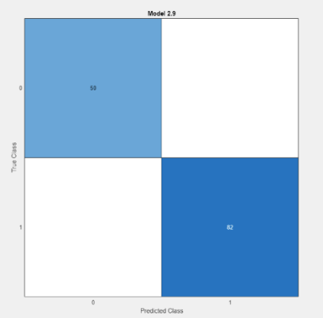
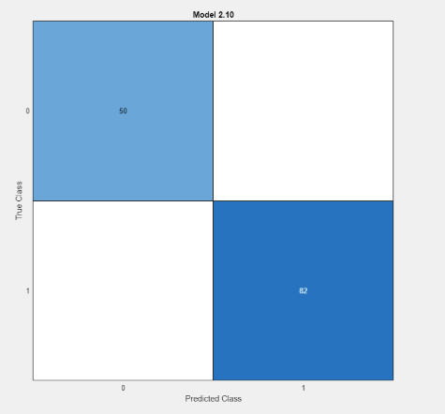
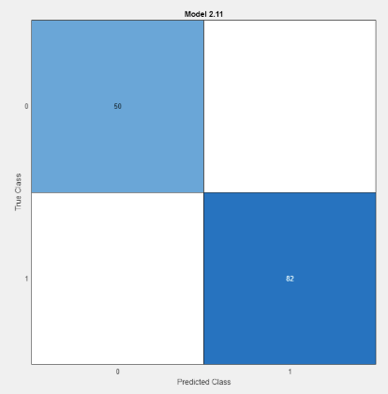
Objective-Wise Results (contd.,):
Support Vector Machine result with 67:33 training and testing ratio
Linear SVM Quadratic SVM Cubic SVM

Slide 33
Objective-Wise Results (contd.,):
Analysis of CKD using different types of SVM under 67:33 training and testing ratio
Types of SVM | Training Accuracy | Testing Accuracy | Sensitivity | Selectivity | Precision | F1- Score
Linear SVM | 99.3 | 100 | 100 | 100 | 100 | 100
Quadratic SVM | 98.9 | 100 | 100 | 100 | 100 | 100
Cubic SVM | 98.5 | 100 | 100 | 100 | 100 | 100

Slide 34

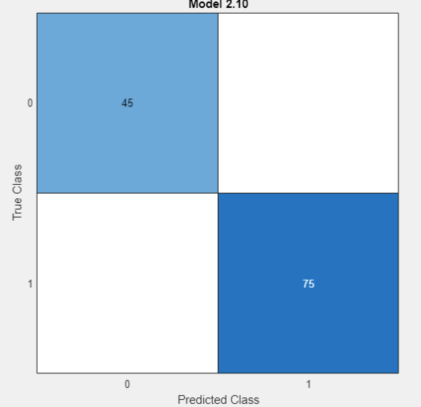
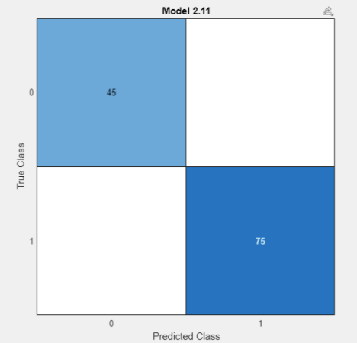
Objective-Wise Results (contd.,):
Support Vector Machine result with 70:30 training and testing ratio
Linear SVM Quadratic SVM Cubic SVM

Slide 35
Objective-Wise Results (contd.,):
Analysis of CKD using different types of SVM under 70:30 training and testing ratio
Types of SVM | Training Accuracy | Testing Accuracy | Sensitivity | Selectivity | Precision | F1- Score
Linear SVM | 98.6 | 100 | 100 | 100 | 100 | 100
Quadratic SVM | 98.2 | 100 | 100 | 100 | 100 | 100
Cubic SVM | 98.6 | 100 | 100 | 100 | 100 | 100

Slide 36



Objective-Wise Results (contd.,):
Support Vector Machine result with 80:20 training and testing ratio
Linear SVM Quadratic SVM Cubic SVM

Slide 37
Objective-Wise Results (contd.,):
Analysis of CKD using different types of SVM under 80:20 training and testing ratio
Types of SVM | Training Accuracy | Testing Accuracy | Sensitivity | Selectivity | Precision | F1- Score
Linear SVM | 98.4 | 100 | 100 | 100 | 100 | 100
Quadratic SVM | 99.1 | 100 | 100 | 100 | 100 | 100
Cubic SVM | 99.4 | 100 | 100 | 100 | 100 | 100

Slide 38
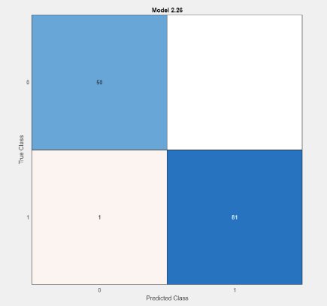
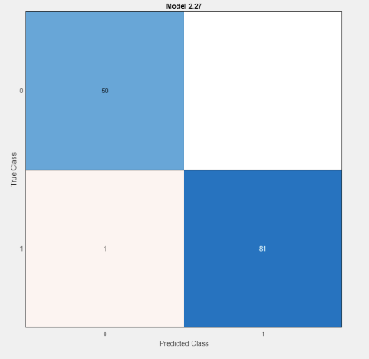
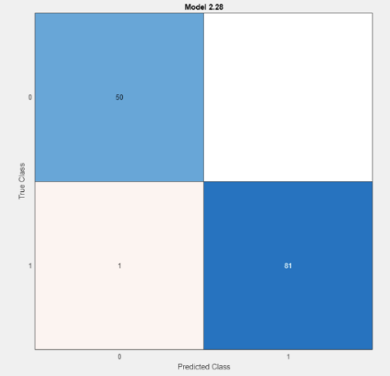
Objective-Wise Results (contd.,):
Neural Networks result with 67:33 training and testing ratio
Narrow NN Medium NN Wide NN

Slide 39
Objective-Wise Results (contd.,):
Analysis of CKD using different types of NN under 67:33 training and testing ratio
Types of NN | Training Accuracy | Testing Accuracy | Sensitivity | Selectivity | Precision | F1- Score
Linear NN | 98.1 | 99.2 | 98 | 100 | 100 | 98.98
Quadratic NN | 98.9 | 99.2 | 98 | 100 | 100 | 98.98
Cubic NN | 99.3 | 99.2 | 98 | 100 | 100 | 98.98

Slide 40
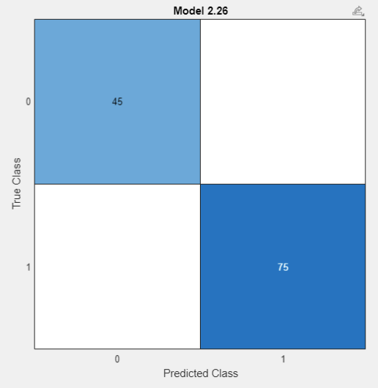
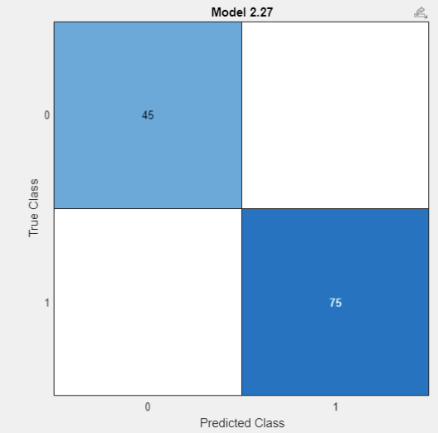

Objective-Wise Results (contd.,):
Neural Networks result with 70:30 training and testing ratio
Narrow NN Medium NN Wide NN

Slide 41
Objective-Wise Results (contd.,):
Analysis of CKD using different types of NN under 70:30 training and testing ratio
Types of NN | Training Accuracy | Testing Accuracy | Sensitivity | Selectivity | Precision | F1- Score
Linear NN | 98.9 | 100 | 100 | 100 | 100 | 100
Quadratic NN | 98.6 | 100 | 100 | 100 | 100 | 100
Cubic NN | 98.9 | 100 | 100 | 100 | 100 | 100

Slide 42

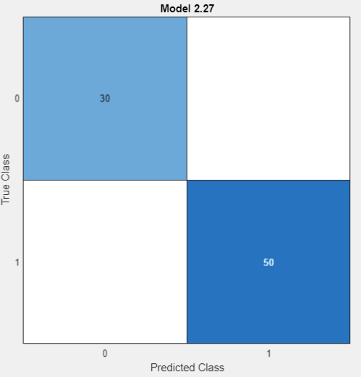

Objective-Wise Results (contd.,):
Neural Networks result with 80:20 training and testing ratio
Narrow NN Medium NN Wide NN

Slide 43
Objective-Wise Results (contd.,):
Analysis of CKD using different types of NN under 80:20 training and testing ratio
Types of NN | Training Accuracy | Testing Accuracy | Sensitivity | Selectivity | Precision | F1- Score
Linear NN | 98.8 | 100 | 100 | 100 | 100 | 100
Quadratic NN | 98.8 | 100 | 100 | 100 | 100 | 100
Cubic NN | 99.4 | 100 | 100 | 100 | 100 | 100

Slide 44
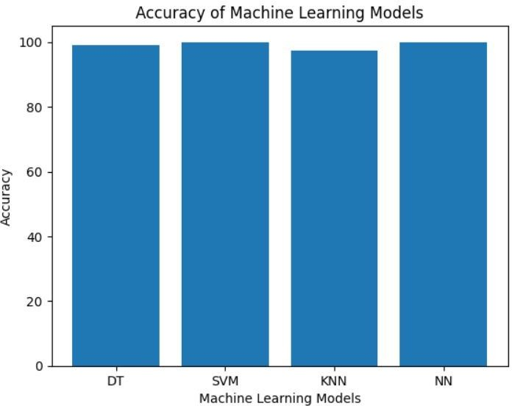
Objective-Wise Results (contd.,):
Analysis of CKD using 4 machine learning algorithms under 67:33 ratio
Accuracy

Slide 45
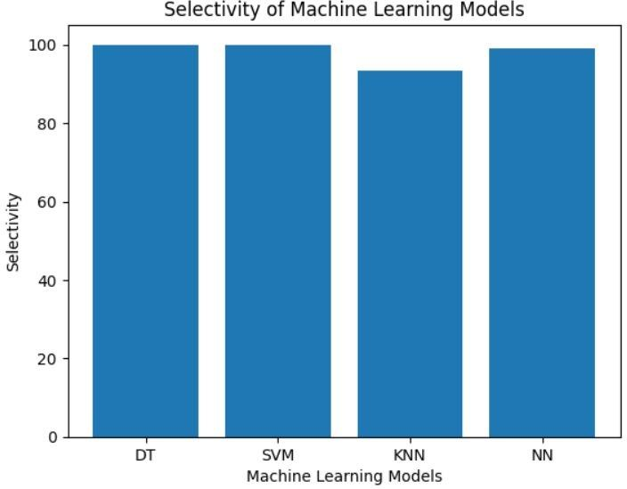
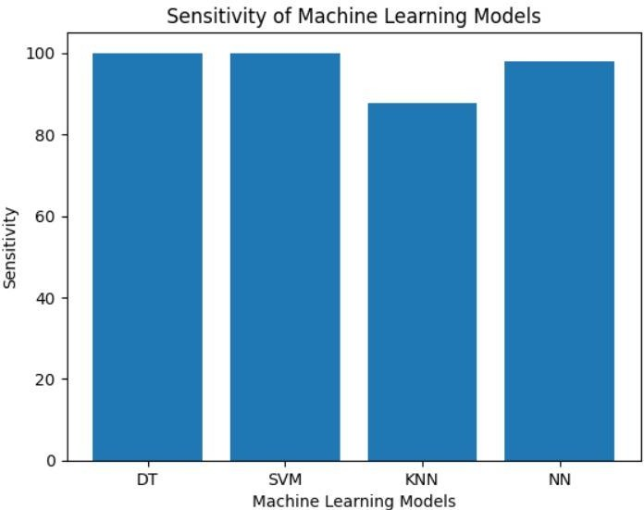
Objective-Wise Results (contd.,):
Analysis of CKD using 4 machine learning algorithms under 67:33 ratio
Selectivity Sensitivity

Slide 46
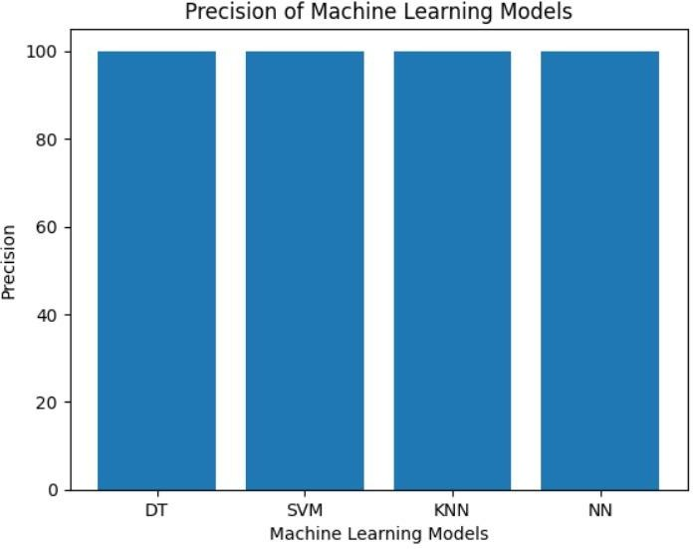
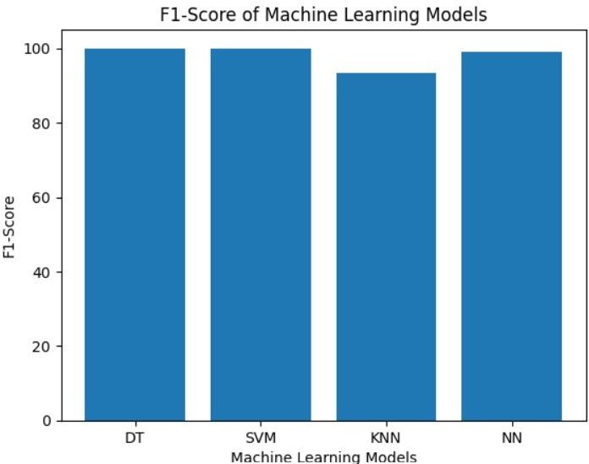
Objective-Wise Results (contd.,):
Analysis of CKD using 4 machine learning algorithms under 67:33 ratio
Precision F1-Score

Slide 47
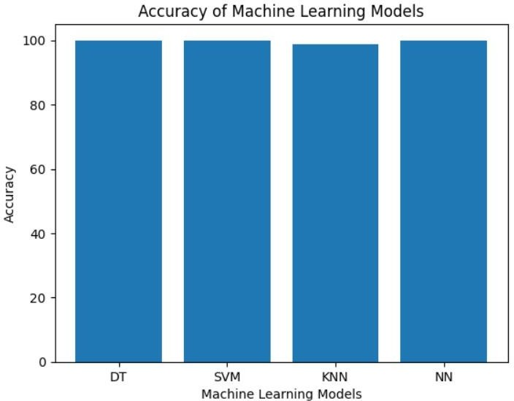
Objective-Wise Results (contd.,):
Analysis of CKD using 4 machine learning algorithms under 70:30 ratio
Accuracy

Slide 48
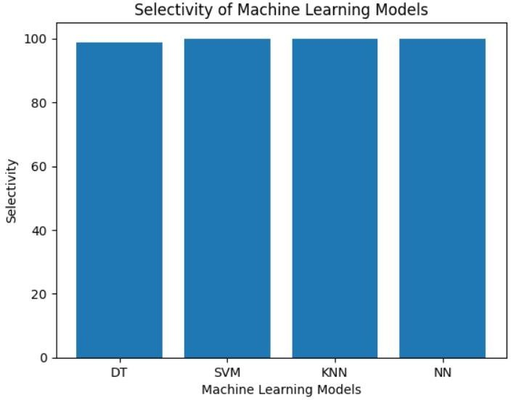
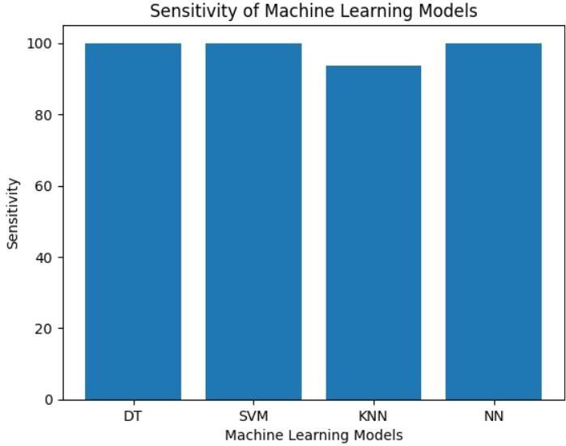
Objective-Wise Results (contd.,):
Analysis of CKD using 4 machine learning algorithms under 70:30 ratio
Selectivity Sensitivity

Slide 49
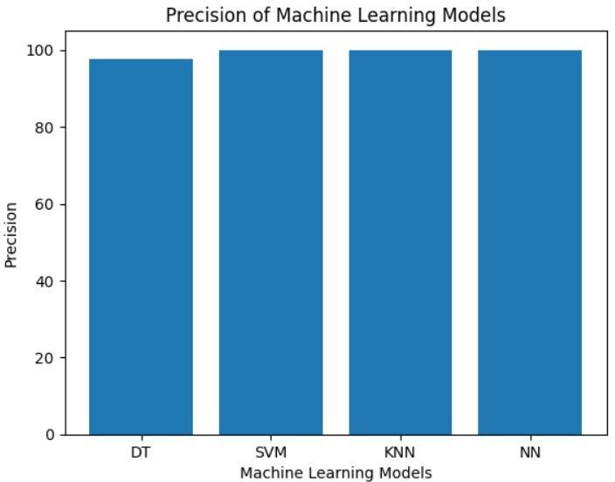
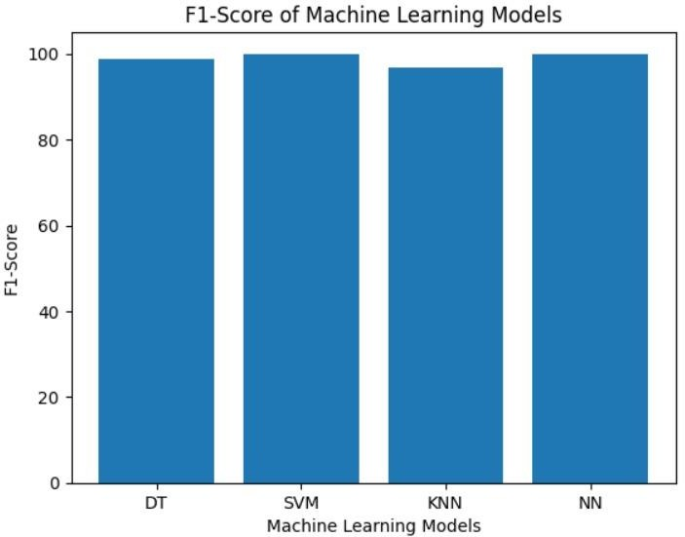
Objective-Wise Results (contd.,):
Analysis of CKD using 4 machine learning algorithms under 70:30 ratio
Precision F1-Score

Slide 50
Objective-Wise Results (contd.,):
Analysis of CKD using 4 machine learning algorithms under 80:20 ratio
Accuracy

Slide 51
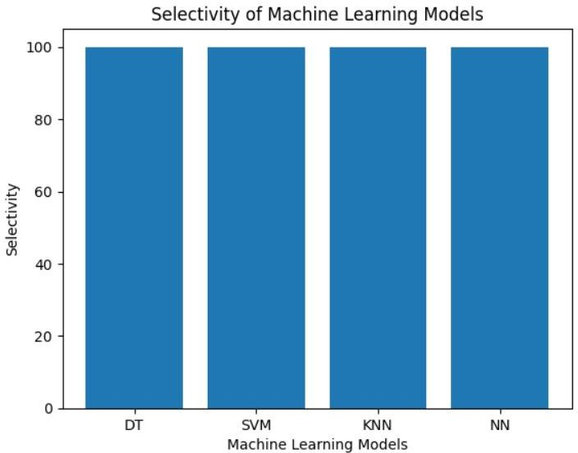
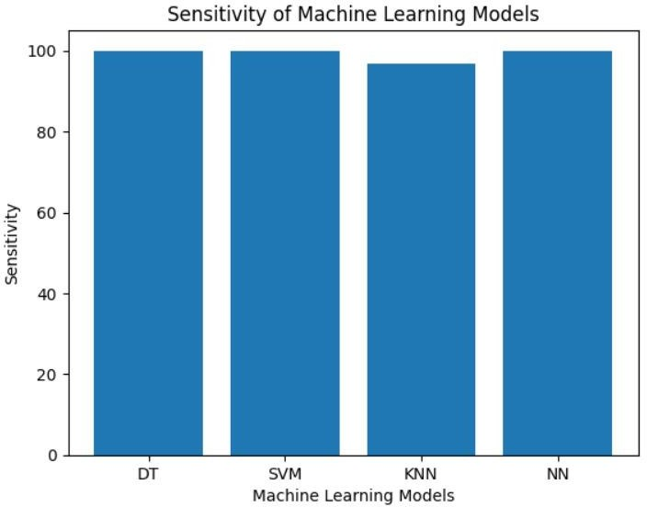
Objective-Wise Results (contd.,):
Analysis of CKD using 4 machine learning algorithms under 80:20 ratio
Selectivity Sensitivity

Slide 52
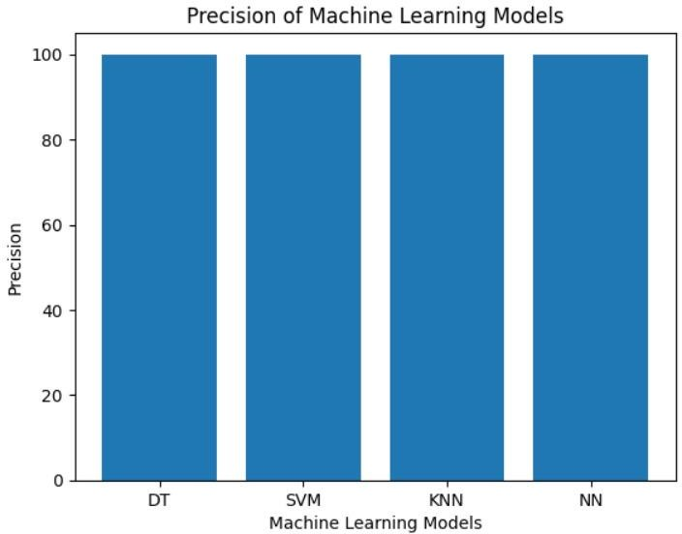

Objective-Wise Results (contd.,):
Analysis of CKD using 4 machine learning algorithms under 80:20 ratio
Precision F1-Score

Slide 53

Objective-Wise Results (contd.,):
Graphical representation of our dataset using ANOVA feature selection algorithm for 70:30 training testing ratio is shown below:

Slide 54
Objective-Wise Results (contd.,):
Tabular representation of our dataset using ANOVA feature selection algorithm for 70:30 training testing ratio is shown below:
S.no
1
2
3
4
5
6
7
8
9
10
11
12
Features | Ranking Score
Hemoglobin | 128.1095
Packed Cell Volume | 113.4271
Specific Gravity | 90.1703
Red Blood Cells Count | 76.8057
Hypertension | 67.0163
Diabetes Mellitus | 59.9569
Albumin | 51.9200
Blood Glucose Random | 25.4195
Appetite | 24.7014
Pedal Edema | 23.0572
Pus Cells | 23.0572
Blood Urea | 21.6901
S.no | Features | Ranking Score
13 | Red Blood Cells | 19.9407
14 | Sodium | 19.3683
15 | Anemia | 17.0309
16 | Blood Pressure | 15.0499
17 | Sugar | 13.1436
18 | Serum Creatinine | 12.8552
19 | Age | 11.4831
20 | Pus Cell Clumps | 10.5045
21 | Coronary Artery Disease | 8.9119
22 | Bacteria | 6.6110
23 | White Blood Cells | 6.5396
24 | Potassium | 1.0677

Slide 55
Objective-Wise Results (contd.,):
Analysis of CKD with the use of the ANOVA feature selection algorithm and 22 attributes from the chosen dataset with a 70:30 training to testing ratio
Algorithm | Training Accuracy | Testing Accuracy
Fine Tree | 97.9 | 99.2
Medium Tree | 97.9 | 99.2
Coarse Tree | 97.9 | 99.2
Linear SVM | 98.9 | 97.5
Quadratic SVM | 99.6 | 98.3
Cubic SVM | 100 | 98.3
Fine KNN | 98.2 | 95.8
Medium KNN | 94.3 | 90.8
Coarse KNN | 77.5 | 80
Narrow NN | 98.9 | 97.5
Medium NN | 99.3 | 97.5
Wide NN | 99.3 | 98.3

Slide 56
Objective-Wise Results (contd.,):
Analysis of CKD with the use of the ANOVA feature selection algorithm and 20 attributes from the chosen dataset with a 70:30 training to testing ratio
Algorithm | Training Accuracy | Testing Accuracy
Fine Tree | 97.9 | 99.2
Medium Tree | 97.9 | 99.2
Coarse Tree | 97.9 | 99.2
Linear SVM | 98.9 | 100
Quadratic SVM | 99.6 | 98.3
Cubic SVM | 99.6 | 95.8
Fine KNN | 98.9 | 95.8
Medium KNN | 95 | 90.8
Coarse KNN | 80.4 | 80
Narrow NN | 98.9 | 98.3
Medium NN | 98.9 | 97.5
Wide NN | 99.3 | 98.3

Slide 57
Objective-Wise Results (contd.,):
Analysis of CKD with the use of the ANOVA feature selection algorithm and 18 attributes from the chosen dataset with a 70:30 training to testing ratio
Algorithm | Training Accuracy | Testing Accuracy
Fine Tree | 97.9 | 99.2
Medium Tree | 97.9 | 99.2
Coarse Tree | 97.9 | 99.2
Linear SVM | 98.9 | 97.5
Quadratic SVM | 99.6 | 98.3
Cubic SVM | 99.6 | 97.5
Fine KNN | 99.6 | 96.7
Medium KNN | 96.8 | 93.3
Coarse KNN | 81.4 | 80.8
Narrow NN | 98.9 | 97.5
Medium NN | 99.3 | 98.3
Wide NN | 98.9 | 98.3

Slide 58
Objective-Wise Results (contd.,):
Analysis of CKD with the use of the ANOVA feature selection algorithm and 16 attributes from the chosen dataset with a 70:30 training to testing ratio
Algorithm | Training Accuracy | Testing Accuracy
Fine Tree | 97.9 | 99.2
Medium Tree | 97.9 | 99.2
Coarse Tree | 97.9 | 99.2
Linear SVM | 99.3 | 96.7
Quadratic SVM | 99.6 | 96.7
Cubic SVM | 100 | 96.7
Fine KNN | 99.6 | 96.7
Medium KNN | 96.8 | 94.2
Coarse KNN | 83.9 | 80.8
Narrow NN | 98.6 | 96.7
Medium NN | 99.3 | 97.5
Wide NN | 99.6 | 97.5

Slide 59
Objective-Wise Results (contd.,):
Analysis of CKD with the use of the ANOVA feature selection algorithm and 14 attributes from the chosen dataset with a 70:30 training to testing ratio
Algorithm | Training Accuracy | Testing Accuracy
Fine Tree | 99.3 | 99.2
Medium Tree | 99.3 | 99.2
Coarse Tree | 99.3 | 99.2
Linear SVM | 99.6 | 96.7
Quadratic SVM | 100 | 95.8
Cubic SVM | 100 | 96.7
Fine KNN | 99.3 | 98.3
Medium KNN | 96.8 | 94.2
Coarse KNN | 83.9 | 81.7
Narrow NN | 98.6 | 97.5
Medium NN | 98.6 | 98.3
Wide NN | 98.9 | 97.5

Slide 60

Objective-Wise Results (contd.,):
Graphical representation of our dataset using ANOVA feature selection algorithm for 80:20 training testing ratio is shown below:

Slide 61
Objective-Wise Results (contd.,):
Tabular representation of our dataset using ANOVA feature selection algorithm for 80:20 training testing ratio is shown below:
S.no
1
2
3
4
5
6
7
8
9
10
11
12
Features | Ranking Score
Hemoglobin | 153.4453
Packed Cell Volume | 122.1756
Specific Gravity | 108.7255
Red Blood Cells Count | 98.2894
Hypertension | 68.9265
Albumin | 63.8054
Diabetes Mellitus | 61.5170
Pus Cells | 31.4744
Pedal Edema | 30.2959
Appetite | 30.2959
Blood Glucose Random | 28.4465
Blood Urea | 26.9134
S.no | Features | Ranking Score
13 | Red Blood Cells | 22.7292
14 | Sodium | 22.0339
15 | Anemia | 20.2801
16 | Sugar | 16.7110
17 | Serum Creatinine | 15.1035
18 | Pus Cell Count | 14.0095
19 | Blood Pressure | 13.1880
20 | Age | 11.9371
21 | Coronary Artery Disease | 11.5467
22 | White Blood Cells | 9.0916
23 | Bacteria | 7.3038
24 | Potassium | 1.5777

Slide 62
Objective-Wise Results (contd.,):
Analysis of CKD with the use of the ANOVA feature selection algorithm and 22 attributes from the chosen dataset with a 80:20 training to testing ratio
Algorithm | Training Accuracy | Testing Accuracy
Fine Tree | 99.1 | 98.8
Medium Tree | 99.1 | 98.8
Coarse Tree | 99.1 | 98.8
Linear SVM | 99.4 | 98.8
Quadratic SVM | 99.4 | 100
Cubic SVM | 99.7 | 100
Fine KNN | 98.8 | 95
Medium KNN | 94.7 | 93.8
Coarse KNN | 79.7 | 77.5
Narrow NN | 99.4 | 97.5
Medium NN | 99.4 | 98.8
Wide NN | 99.4 | 98.8

Slide 63
Objective-Wise Results (contd.,):
Analysis of CKD with the use of the ANOVA feature selection algorithm and 20 attributes from the chosen dataset with a 80:20 training to testing ratio
Algorithm | Training Accuracy | Testing Accuracy
Fine Tree | 99.1 | 98.8
Medium Tree | 99.1 | 98.8
Coarse Tree | 99.1 | 98.8
Linear SVM | 99.1 | 98.8
Quadratic SVM | 99.7 | 100
Cubic SVM | 99.7 | 100
Fine KNN | 99.1 | 98.8
Medium KNN | 97.5 | 96.2
Coarse KNN | 81.9 | 82.5
Narrow NN | 99.4 | 98.8
Medium NN | 99.7 | 98.8
Wide NN | 99.1 | 98.8

Slide 64
Objective-Wise Results (contd.,):
Analysis of CKD with the use of the ANOVA feature selection algorithm and 18 attributes from the chosen dataset with a 80:20 training to testing ratio
Algorithm | Training Accuracy | Testing Accuracy
Fine Tree | 99.1 | 100
Medium Tree | 99.1 | 100
Coarse Tree | 99.1 | 100
Linear SVM | 99.1 | 100
Quadratic SVM | 99.4 | 100
Cubic SVM | 99.4 | 100
Fine KNN | 99.1 | 98.8
Medium KNN | 97.8 | 98.8
Coarse KNN | 83.4 | 85
Narrow NN | 99.4 | 98.8
Medium NN | 99.1 | 100
Wide NN | 99.4 | 100

Slide 65
Objective-Wise Results (contd.,):
Analysis of CKD with the use of the ANOVA feature selection algorithm and 16 attributes from the chosen dataset with a 80:20 training to testing ratio
Algorithm | Training Accuracy | Testing Accuracy
Fine Tree | 99.1 | 100
Medium Tree | 99.1 | 100
Coarse Tree | 99.1 | 100
Linear SVM | 99.1 | 98.8
Quadratic SVM | 99.1 | 98.8
Cubic SVM | 99.1 | 98.8
Fine KNN | 100 | 98.8
Medium KNN | 98.4 | 97.5
Coarse KNN | 83.4 | 86.2
Narrow NN | 98.8 | 100
Medium NN | 99.4 | 98.8
Wide NN | 99.1 | 98.8

Slide 66
Objective-Wise Results (contd.,):
Analysis of CKD with the use of the ANOVA feature selection algorithm and 14 attributes from the chosen dataset with a 80:20 training to testing ratio
Algorithm | Training Accuracy | Testing Accuracy
Fine Tree | 99.1 | 100
Medium Tree | 99.1 | 100
Coarse Tree | 99.1 | 100
Linear SVM | 98.8 | 98.8
Quadratic SVM | 98.8 | 98.8
Cubic SVM | 98.4 | 98.8
Fine KNN | 99.4 | 98.8
Medium KNN | 97.8 | 98.8
Coarse KNN | 83.4 | 85
Narrow NN | 99.4 | 98.8
Medium NN | 99.1 | 98.8
Wide NN | 99.1 | 98.8

Slide 67

Objective-Wise Results (contd.,):
Graphical representation of our dataset using ANOVA feature selection algorithm for 67:33 training testing ratio is shown below:

Slide 68
Objective-Wise Results (contd.,):
Tabular representation of our dataset using ANOVA feature selection algorithm for 67:33 training testing ratio is shown below:
S.no
1
2
3
4
5
6
7
8
9
10
11
12
Features | Ranking Score
Hemoglobin | 128.8637
Packed Cell Volume | 104.4860
Specific Gravity | 87.3147
Red Blood Cells Count | 74.4654
Hypertension | 55.1095
Diabetes Mellitus | 53.0275
Albumin | 50.5547
Blood Glucose Random | 26.6684
Blood Urea | 25.3581
Pus Cells | 23.1844
Appetite | 22.6387
Sodium | 20.4729
S.no | Features | Ranking Score
13 | Pedal Edema | 20.0108
14 | Red Blood Cells | 17.5373
15 | Anemia | 16.1206
16 | Sugar | 14.0546
17 | Serum Creatinine | 13.5428
18 | Pus Cells Count | 13.4242
19 | Blood Pressure | 13.0083
20 | Coronary Artery Disease | 9.6766
21 | Age | 8.8810
22 | Bacteria | 5.8362
23 | White Blood Cells | 4.5912
24 | Pottasium | 1.0770

Slide 69
Objective-Wise Results (contd.,):
Analysis of CKD with the use of the ANOVA feature selection algorithm and 22 attributes from the chosen dataset with a 67:33 training to testing ratio
Algorithm | Training Accuracy | Testing Accuracy
Fine Tree | 98.9 | 99.2
Medium Tree | 98.9 | 99.2
Coarse Tree | 98.9 | 99.2
Linear SVM | 99.3 | 98.5
Quadratic SVM | 99.3 | 99.2
Cubic SVM | 99.3 | 99.2
Fine KNN | 98.9 | 98.5
Medium KNN | 97 | 95.5
Coarse KNN | 74.6 | 94.7
Narrow NN | 98.5 | 99.2
Medium NN | 98.9 | 100
Wide NN | 98.5 | 100

Slide 70
Objective-Wise Results (contd.,):
Analysis of CKD with the use of the ANOVA feature selection algorithm and 20 attributes from the chosen dataset with a 67:33 training to testing ratio
Algorithm | Training Accuracy | Testing Accuracy
Fine Tree | 98.9 | 99.2
Medium Tree | 98.9 | 99.2
Coarse Tree | 98.9 | 99.2
Linear SVM | 99.3 | 99.2
Quadratic SVM | 99.6 | 99.2
Cubic SVM | 99.3 | 99.2
Fine KNN | 99.6 | 99.2
Medium KNN | 97 | 97
Coarse KNN | 79.1 | 83.3
Narrow NN | 98.5 | 99.2
Medium NN | 99.3 | 100
Wide NN | 98.9 | 100

Slide 71
Objective-Wise Results (contd.,):
Analysis of CKD with the use of the ANOVA feature selection algorithm and 18 attributes from the chosen dataset with a 67:33 training to testing ratio
Algorithm | Training Accuracy | Testing Accuracy
Fine Tree | 98.9 | 99.2
Medium Tree | 98.9 | 99.2
Coarse Tree | 98.9 | 99.2
Linear SVM | 99.3 | 97.5
Quadratic SVM | 99.3 | 98.3
Cubic SVM | 99.3 | 98.3
Fine KNN | 99.6 | 95.8
Medium KNN | 97.4 | 90.8
Coarse KNN | 7 | 80
Narrow NN | 98.9 | 97.5
Medium NN | 99.3 | 97.5
Wide NN | 99.3 | 98.3

Slide 72
Objective-Wise Results (contd.,):
Analysis of CKD with the use of the ANOVA feature selection algorithm and 16 attributes from the chosen dataset with a 67:33 training to testing ratio
Algorithm | Training Accuracy | Testing Accuracy
Fine Tree | 98.9 | 99.2
Medium Tree | 98.9 | 99.2
Coarse Tree | 98.9 | 99.2
Linear SVM | 99.3 | 98.5
Quadratic SVM | 100 | 98.5
Cubic SVM | 99.6 | 98.5
Fine KNN | 100 | 99.2
Medium KNN | 97.8 | 97
Coarse KNN | 82.1 | 84.8
Narrow NN | 98.9 | 99.2
Medium NN | 98.5 | 100
Wide NN | 99.6 | 100

Slide 73
Objective-Wise Results (contd.,):
Analysis of CKD with the use of the ANOVA feature selection algorithm and 14 attributes from the chosen dataset with a 67:33 training to testing ratio
Algorithm | Training Accuracy | Testing Accuracy
Fine Tree | 98.9 | 99.2
Medium Tree | 98.9 | 99.2
Coarse Tree | 98.9 | 99.2
Linear SVM | 99.3 | 98.5
Quadratic SVM | 99.6 | 98.5
Cubic SVM | 99.3 | 99.2
Fine KNN | 100 | 99.2
Medium KNN | 97 | 97
Coarse KNN | 85.4 | 87.1
Narrow NN | 98.9 | 99.2
Medium NN | 99.3 | 99.2
Wide NN | 99.3 | 100

Slide 74

Objective-Wise Results (contd.,):
Graphical representation of our dataset using MRMR feature selection algorithm for 70:30 training testing ratio is shown below:

Slide 75
Objective-Wise Results (contd.,):
Tabular representation of our dataset using MRMR feature selection algorithm for 70:30 training testing ratio is shown below:
S.no
1
2
3
4
5
6
7
8
9
10
11
12
Features | Ranking Score
Hemoglobin | 0.5077
White Blood Cells | 0.0109
Red Blood Cells | 0.0092
Sugar | 0.0092
Specific Gravity | 0.0081
Serum Creatinine | 0.0072
Pedal Edema | 0.0069
Albumin | 0.0063
Appetite | 0.0061
Sodium | 0.0056
Hypertension | 0.0054
Pus Cells | 0.0053
S.no | Features | Ranking Score
13 | Anemia | 0.0053
14 | Diabetes Mellitus | 0.0052
15 | Bacteria | 0.0052
16 | Blood Glucose Random | 0.0047
17 | Coronary Artery Disease | 0.0045
18 | Pus Cell Count | 0.0042
19 | Blood Pressure | 0.0040
20 | Blood Urea | 0.0040
21 | Packed Cell Volume | 0.0038
22 | Red Blood Cells Count | 0.0027
23 | Age | 0.0007
24 | Potassium | 0

Slide 76
Objective-Wise Results (contd.,):
Analysis of CKD with the use of the MRMR feature selection algorithm and 22 attributes from the chosen dataset with a 70:30 training to testing ratio
Algorithm | Training Accuracy | Testing Accuracy
Fine Tree | 98.6 | 99.2
Medium Tree | 98.6 | 99.2
Coarse Tree | 98.6 | 99.2
Linear SVM | 99.3 | 99.2
Quadratic SVM | 98.9 | 100
Cubic SVM | 99.3 | 100
Fine KNN | 98.6 | 100
Medium KNN | 95.7 | 98.3
Coarse KNN | 77.1 | 82.5
Narrow NN | 99.6 | 100
Medium NN | 99.6 | 99.2
Wide NN | 99.3 | 99.2

Slide 77
Objective-Wise Results (contd.,):
Analysis of CKD with the use of the MRMR feature selection algorithm and 20 attributes from the chosen dataset with a 70:30 training to testing ratio
Algorithm | Training Accuracy | Testing Accuracy
Fine Tree | 98.6 | 98.3
Medium Tree | 98.6 | 98.3
Coarse Tree | 98.6 | 98.3
Linear SVM | 98.9 | 99.2
Quadratic SVM | 98.9 | 99.2
Cubic SVM | 99.3 | 99.2
Fine KNN | 98.9 | 99.2
Medium KNN | 96.4 | 98.3
Coarse KNN | 76.8 | 76.7
Narrow NN | 99.6 | 99.2
Medium NN | 99.6 | 99.2
Wide NN | 99.6 | 99.2

Slide 78
Objective-Wise Results (contd.,):
Analysis of CKD with the use of the MRMR feature selection algorithm and 18 attributes from the chosen dataset with a 70:30 training to testing ratio
Algorithm | Training Accuracy | Testing Accuracy
Fine Tree | 98.6 | 99.2
Medium Tree | 98.6 | 99.2
Coarse Tree | 98.6 | 99.2
Linear SVM | 99.3 | 99.2
Quadratic SVM | 98.2 | 99.2
Cubic SVM | 98.6 | 99.2
Fine KNN | 99.3 | 100
Medium KNN | 96.8 | 98.3
Coarse KNN | 76.4 | 79.2
Narrow NN | 99.3 | 100
Medium NN | 98.9 | 99.2
Wide NN | 99.3 | 100

Slide 79
Objective-Wise Results (contd.,):
Analysis of CKD with the use of the MRMR feature selection algorithm and 16 attributes from the chosen dataset with a 70:30 training to testing ratio
Algorithm | Training Accuracy | Testing Accuracy
Fine Tree | 98.6 | 99.2
Medium Tree | 98.6 | 99.2
Coarse Tree | 98.6 | 99.2
Linear SVM | 99.3 | 99.2
Quadratic SVM | 98.6 | 99.2
Cubic SVM | 98.9 | 99.2
Fine KNN | 98.9 | 100
Medium KNN | 96.1 | 99.2
Coarse KNN | 76.8 | 80.8
Narrow NN | 99.3 | 99.2
Medium NN | 99.3 | 99.2
Wide NN | 98.9 | 99.2

Slide 80
Objective-Wise Results (contd.,):
Analysis of CKD with the use of the MRMR feature selection algorithm and 14 attributes from the chosen dataset with a 70:30 training to testing ratio
Algorithm | Training Accuracy | Testing Accuracy
Fine Tree | 98.6 | 99.2
Medium Tree | 98.6 | 99.2
Coarse Tree | 98.6 | 99.2
Linear SVM | 98.9 | 99.2
Quadratic SVM | 98.6 | 99.2
Cubic SVM | 98.9 | 99.2
Fine KNN | 99.3 | 100
Medium KNN | 96.1 | 99.2
Coarse KNN | 96.4 | 80.8
Narrow NN | 99.3 | 99.2
Medium NN | 99.3 | 98.3
Wide NN | 99.6 | 99.2

Slide 81

Objective-Wise Results (contd.,):
Graphical representation of our dataset using MRMR feature selection algorithm for 80:20 training testing ratio is shown below:

Slide 82
Objective-Wise Results (contd.,):
Tabular representation of our dataset using MRMR feature selection algorithm for 80:20 training testing ratio is shown below:
S.no
1
2
3
4
5
6
7
8
9
10
11
12
Features | Ranking Score
Hemoglobin | 0.4444
Potassium | 0.3901
Sugar | 0.0000
Red Blood Cells | 0.0000
Coronary Artery Disease | 0.0000
Pedal Edema | 0.0000
Specific Gravity | 0.0000
Appetite | 0.0000
Blood Pressure | 0.0000
Albumin | 0.0000
Serum Creatinine | 0.0000
Diabetes Mellitus | 0.0000
S.no | Features | Ranking Score
13 | Pus Cell Count | 0.0000
14 | Anemia | 0.0000
15 | Sodium | 0.0000
16 | Packed Cell Volume | 0.0000
17 | Pus Cells | 0.0000
18 | Hypertension | 0.0000
19 | Blood Glucose Random | 0.0000
20 | Blood Urea | 0.0000
21 | Bacteria | 0.0000
22 | Red Blood Cells Count | 0.0000
23 | White Blood Cells | 0.0000
24 | Age | 0.0000

Slide 83
Objective-Wise Results (contd.,):
Analysis of CKD with the use of the MRMR feature selection algorithm and 22 attributes from the chosen dataset with a 80:20 training to testing ratio
Algorithm | Training Accuracy | Testing Accuracy
Fine Tree | 99.1 | 100
Medium Tree | 99.1 | 100
Coarse Tree | 99.1 | 100
Linear SVM | 98.8 | 100
Quadratic SVM | 99.4 | 100
Cubic SVM | 99.4 | 100
Fine KNN | 99.1 | 100
Medium KNN | 95.3 | 100
Coarse KNN | 79.4 | 83.8
Narrow NN | 98.4 | 100
Medium NN | 98.1 | 100
Wide NN | 98.8 | 100

Slide 84
Objective-Wise Results (contd.,):
Analysis of CKD with the use of the MRMR feature selection algorithm and 20 attributes from the chosen dataset with a 80:20 training to testing ratio
Algorithm | Training Accuracy | Testing Accuracy
Fine Tree | 99.1 | 100
Medium Tree | 99.1 | 100
Coarse Tree | 99.1 | 100
Linear SVM | 98.8 | 100
Quadratic SVM | 99.4 | 100
Cubic SVM | 99.7 | 100
Fine KNN | 99.1 | 100
Medium KNN | 95.6 | 100
Coarse KNN | 80.9 | 81.2
Narrow NN | 99.1 | 100
Medium NN | 99.4 | 100
Wide NN | 99.1 | 100

Slide 85
Objective-Wise Results (contd.,):
Analysis of CKD with the use of the MRMR feature selection algorithm and 18 attributes from the chosen dataset with a 80:20 training to testing ratio
Algorithm | Training Accuracy | Testing Accuracy
Fine Tree | 99.1 | 100
Medium Tree | 99.1 | 100
Coarse Tree | 99.1 | 100
Linear SVM | 99.1 | 100
Quadratic SVM | 99.1 | 100
Cubic SVM | 99.1 | 100
Fine KNN | 99.1 | 100
Medium KNN | 95.9 | 98.8
Coarse KNN | 80.6 | 81.2
Narrow NN | 99.1 | 100
Medium NN | 98.8 | 100
Wide NN | 98.8 | 100

Slide 86
Objective-Wise Results (contd.,):
Analysis of CKD with the use of the MRMR feature selection algorithm and 16 attributes from the chosen dataset with a 80:20 training to testing ratio
Algorithm | Training Accuracy | Testing Accuracy
Fine Tree | 99.1 | 100
Medium Tree | 99.1 | 100
Coarse Tree | 99.1 | 100
Linear SVM | 99.1 | 100
Quadratic SVM | 99.1 | 100
Cubic SVM | 99.4 | 100
Fine KNN | 99.1 | 100
Medium KNN | 97.2 | 98.8
Coarse KNN | 81.9 | 80
Narrow NN | 98.1 | 100
Medium NN | 98.1 | 100
Wide NN | 98.8 | 100

Slide 87
Objective-Wise Results (contd.,):
Analysis of CKD with the use of the MRMR feature selection algorithm and 14 attributes from the chosen dataset with a 80:20 training to testing ratio
Algorithm | Training Accuracy | Testing Accuracy
Fine Tree | 98.8 | 100
Medium Tree | 98.8 | 100
Coarse Tree | 98.8 | 100
Linear SVM | 99.4 | 100
Quadratic SVM | 99.4 | 100
Cubic SVM | 99.4 | 100
Fine KNN | 99.1 | 100
Medium KNN | 97.5 | 100
Coarse KNN | 81.2 | 76.2
Narrow NN | 98.4 | 100
Medium NN | 98.8 | 100
Wide NN | 98.4 | 100

Slide 88

Objective-Wise Results (contd.,):
Graphical representation of our dataset using MRMR feature selection algorithm for 67:33 training testing ratio is shown below:

Slide 89
Objective-Wise Results (contd.,):
Tabular representation of our dataset using MRMR feature selection algorithm for 67:33 training testing ratio is shown below:
S.no
1
2
3
4
5
6
7
8
9
10
11
12
Features | Ranking Score
Hemoglobin | 0.4120
Packed Cell Volume | 0.3659
Specific Gravity | 0.3466
Red Blood Cells Count | 0.3270
Hypertension | 0.2696
Diabetes Mellitus | 0.2579
Albumin | 0.2516
Blood Glucose Random | 0.2514
Appetite | 0.2424
Pedal Edema | 0.2204
Pus Cells | 0.2185
Blood Urea | 0.2085
S.no | Features | Ranking Score
13 | Red Blood Cells | 0.1937
14 | Sodium | 0.1738
15 | Anemia | 0.1721
16 | Blood Pressure | 0.1716
17 | Sugar | 0.1683
18 | Serum Creatinine | 0.1626
19 | Age | 0.1531
20 | Pus Cell Clumps | 0.1531
21 | Coronary Artery Disease | 0.1209
22 | Bacteria | 0.0447
23 | White Blood Cells | 0.0343
24 | Potassium | 0

Slide 90
Objective-Wise Results (contd.,):
Analysis of CKD with the use of the MRMR feature selection algorithm and 22 attributes from the chosen dataset with a 67:33 training to testing ratio
Algorithm | Training Accuracy | Testing Accuracy
Fine Tree | 99.3 | 100
Medium Tree | 99.3 | 100
Coarse Tree | 99.3 | 100
Linear SVM | 98.9 | 97.7
Quadratic SVM | 99.3 | 98.5
Cubic SVM | 99.3 | 99.2
Fine KNN | 97.8 | 97
Medium KNN | 94.8 | 89.4
Coarse KNN | 77.6 | 74.2
Narrow NN | 98.5 | 99.0
Medium NN | 98.5 | 98.5
Wide NN | 99.6 | 99.2

Slide 91
Objective-Wise Results (contd.,):
Analysis of CKD with the use of the MRMR feature selection algorithm and 20 attributes from the chosen dataset with a 67:33 training to testing ratio
Algorithm | Training Accuracy | Testing Accuracy
Fine Tree | 99.3 | 100
Medium Tree | 99.3 | 100
Coarse Tree | 99.3 | 100
Linear SVM | 98.9 | 97
Quadratic SVM | 99.3 | 97
Cubic SVM | 98.9 | 97.7
Fine KNN | 98.9 | 96.2
Medium KNN | 94.8 | 89.4
Coarse KNN | 75.4 | 74.2
Narrow NN | 98.9 | 99.2
Medium NN | 98.9 | 99.2
Wide NN | 99.3 | 99.2

Slide 92
Objective-Wise Results (contd.,):
Analysis of CKD with the use of the MRMR feature selection algorithm and 18 attributes from the chosen dataset with a 67:33 training to testing ratio
Algorithm | Training Accuracy | Testing Accuracy
Fine Tree | 98.9 | 100
Medium Tree | 98.9 | 100
Coarse Tree | 98.9 | 100
Linear SVM | 99.3 | 97.7
Quadratic SVM | 98.9 | 97.7
Cubic SVM | 98.9 | 97.7
Fine KNN | 98.9 | 98.5
Medium KNN | 94 | 90.2
Coarse KNN | 75.7 | 74.2
Narrow NN | 98.1 | 99.2
Medium NN | 98.9 | 99.2
Wide NN | 98.9 | 99.2

Slide 93
Objective-Wise Results (contd.,):
Analysis of CKD with the use of the MRMR feature selection algorithm and 16 attributes from the chosen dataset with a 67:33 training to testing ratio
Algorithm | Training Accuracy | Testing Accuracy
Fine Tree | 98.9 | 100
Medium Tree | 98.9 | 100
Coarse Tree | 98.9 | 100
Linear SVM | 98.9 | 97.7
Quadratic SVM | 98.9 | 97.7
Cubic SVM | 98.9 | 98.5
Fine KNN | 98.9 | 98.5
Medium KNN | 93.7 | 92.4
Coarse KNN | 74.3 | 77.3
Narrow NN | 98.1 | 99.2
Medium NN | 98.1 | 100
Wide NN | 98.1 | 99.2

Slide 94
Objective-Wise Results (contd.,):
Analysis of CKD with the use of the MRMR feature selection algorithm and 14 attributes from the chosen dataset with a 67:33 training to testing ratio
Algorithm | Training Accuracy | Testing Accuracy
Fine Tree | 98.9 | 100
Medium Tree | 98.9 | 100
Coarse Tree | 98.9 | 100
Linear SVM | 98.9 | 97
Quadratic SVM | 98.9 | 97
Cubic SVM | 98.9 | 97
Fine KNN | 99.3 | 97
Medium KNN | 95.9 | 91.7
Coarse KNN | 72.8 | 76.5
Narrow NN | 98.5 | 100
Medium NN | 98.1 | 100
Wide NN | 98.1 | 100

Slide 95

Objective-Wise Results (contd.,):
Graphical representation of our dataset using CHI2 feature selection algorithm for 70:30 training testing ratio is shown below:

Slide 96
Objective-Wise Results (contd.,):
Tabular representation of our dataset using CHI2 feature selection algorithm for 70:30 training testing ratio is shown below:
S.no
1
2
3
4
5
6
7
8
9
10
11
12
Features | Ranking Score
Hemoglobin | 89.5933
Packed Cell Volume | 83.0080
Serum Creatinine | 74.8812
Specific Gravity | 72.9809
Red Blood Cells Count | 63.9650
Albumin | 56.1788
Diabetes Mellitus | 47.7198
Hypertension | 47.0059
Sodium | 32.8567
Blood Pressure | 28.1293
Blood Glucose Random | 27.3991
Blood Urea | 26.5830
S.no | Features | Ranking Score
13 | Pus Cells | 21.6968
14 | Appetite | 21.2312
15 | Pedal Edema | 19.4063
16 | Red Blood Cells | 18.0754
17 | Potassium | 17.5718
18 | Anemia | 15.5044
19 | Sugar | 13.1901
20 | Age | 13.1589
21 | Pus Cells Count | 9.5349
22 | Coronary Artery Disease | 7.6621
23 | Bacteria | 5.4641
24 | White Blood Cells | 4.4842

Slide 97
Objective-Wise Results (contd.,):
Analysis of CKD with the use of the CHI2 feature selection algorithm and 22 attributes from the chosen dataset with a 70:30 training to testing ratio
Algorithm | Training Accuracy | Testing Accuracy
Fine Tree | 98.6 | 100
Medium Tree | 98.6 | 100
Coarse Tree | 98.6 | 100
Linear SVM | 98.9 | 100
Quadratic SVM | 98.2 | 99.2
Cubic SVM | 99.3 | 100
Fine KNN | 98.9 | 99.2
Medium KNN | 95.7 | 94.2
Coarse KNN | 96.1 | 80
Narrow NN | 99.3 | 98.3
Medium NN | 98.6 | 99.2
Wide NN | 99.3 | 99.2

Slide 98
Objective-Wise Results (contd.,):
Analysis of CKD with the use of the CHI2 feature selection algorithm and 20 attributes from the chosen dataset with a 70:30 training to testing ratio
Algorithm | Training Accuracy | Testing Accuracy
Fine Tree | 98.6 | 100
Medium Tree | 98.6 | 100
Coarse Tree | 98.6 | 100
Linear SVM | 98.9 | 100
Quadratic SVM | 99.3 | 100
Cubic SVM | 99.6 | 100
Fine KNN | 99.3 | 99.2
Medium KNN | 94.6 | 95.8
Coarse KNN | 78.9 | 83.3
Narrow NN | 99.3 | 98.3
Medium NN | 98.6 | 99.2
Wide NN | 98.6 | 100

Slide 99
Objective-Wise Results (contd.,):
Analysis of CKD with the use of the CHI2 feature selection algorithm and 18 attributes from the chosen dataset with a 70:30 training to testing ratio
Algorithm | Training Accuracy | Testing Accuracy
Fine Tree | 98.6 | 100
Medium Tree | 98.6 | 100
Coarse Tree | 98.6 | 100
Linear SVM | 98.6 | 100
Quadratic SVM | 98.9 | 100
Cubic SVM | 98.6 | 100
Fine KNN | 99.6 | 99.2
Medium KNN | 94.6 | 97.5
Coarse KNN | 82.5 | 85
Narrow NN | 98.6 | 98.3
Medium NN | 98.9 | 97.5
Wide NN | 98.6 | 100

Slide 100
Objective-Wise Results (contd.,):
Analysis of CKD with the use of the CHI2 feature selection algorithm and 16 attributes from the chosen dataset with a 70:30 training to testing ratio
Algorithm | Training Accuracy | Testing Accuracy
Fine Tree | 98.6 | 100
Medium Tree | 98.6 | 100
Coarse Tree | 98.6 | 100
Linear SVM | 98.6 | 100
Quadratic SVM | 98.6 | 99.2
Cubic SVM | 98.9 | 100
Fine KNN | 99.6 | 99.2
Medium KNN | 95.4 | 95.8
Coarse KNN | 83.9 | 85.8
Narrow NN | 99.3 | 99.2
Medium NN | 98.9 | 97.5
Wide NN | 98.9 | 99.2

Slide 101
Objective-Wise Results (contd.,):
Analysis of CKD with the use of the CHI2 feature selection algorithm and 14 attributes from the chosen dataset with a 70:30 training to testing ratio
Algorithm | Training Accuracy | Testing Accuracy
Fine Tree | 98.6 | 100
Medium Tree | 98.6 | 100
Coarse Tree | 98.6 | 100
Linear SVM | 98.6 | 100
Quadratic SVM | 98.9 | 100
Cubic SVM | 99.3 | 100
Fine KNN | 99.6 | 99.2
Medium KNN | 96.4 | 97.5
Coarse KNN | 85.7 | 88.3
Narrow NN | 99.3 | 99.2
Medium NN | 98.9 | 99.2
Wide NN | 99.3 | 98.3

Slide 102

Objective-Wise Results (contd.,):
Graphical representation of our dataset using CHI2 feature selection algorithm for 80:20 training testing ratio is shown below:

Slide 103
Objective-Wise Results (contd.,):
Tabular representation of our dataset using CHI2 feature selection algorithm for 80:20 training testing ratio is shown below:
S.no
1
2
3
4
5
6
7
8
9
10
11
12
Features | Ranking Score
Hemoglobin | 104.8710
Packed Cell Volume | 99.2129
Specific Gravity | 90.1037
Serum Creatinine | 87.6322
Red Blood Cells Count | 71.1855
Albumin | 64.9105
Hypertension | 54.9670
Diabetes Mellitus | 50.7458
Sodium | 42.2561
Blood Urea | 30.7890
Blood Pressure | 28.7398
Blood Glucose Random | 28.3763
S.no | Features | Ranking Score
13 | Pus Cells | 26.6612
14 | Appetite | 26.6612
15 | Pedal Edema | 25.7049
16 | Potassium | 24.1096
17 | Red Blood Cells | 21.5702
18 | Anemia | 18.9560
19 | Sugar | 16.1168
20 | Pus Cell Count | 13.2421
21 | Age | 10.4699
22 | Coronary Artery Disease | 9.8101
23 | White Blood Cells | 9.0379
24 | Bacteria | 6.5168

Slide 104
Objective-Wise Results (contd.,):
Analysis of CKD with the use of the CHI2 feature selection algorithm and 22 attributes from the chosen dataset with a 80:20 training to testing ratio
Algorithm | Training Accuracy | Testing Accuracy
Fine Tree | 99.7 | 100
Medium Tree | 99.7 | 100
Coarse Tree | 99.7 | 100
Linear SVM | 98.8 | 100
Quadratic SVM | 99.4 | 100
Cubic SVM | 99.4 | 100
Fine KNN | 98.1 | 100
Medium KNN | 95 | 100
Coarse KNN | 81.9 | 81.2
Narrow NN | 99.1 | 100
Medium NN | 98.1 | 100
Wide NN | 98.8 | 100

Slide 105
Objective-Wise Results (contd.,):
Analysis of CKD with the use of the CHI2 feature selection algorithm and 20 attributes from the chosen dataset with a 80:20 training to testing ratio
Algorithm | Training Accuracy | Testing Accuracy
Fine Tree | 99.4 | 98.8
Medium Tree | 99.4 | 98.8
Coarse Tree | 99.4 | 98.8
Linear SVM | 99.1 | 100
Quadratic SVM | 98.8 | 100
Cubic SVM | 98.8 | 100
Fine KNN | 99.1 | 100
Medium KNN | 96.6 | 98.8
Coarse KNN | 80 | 88.8
Narrow NN | 99.7 | 100
Medium NN | 99.1 | 100
Wide NN | 99.4 | 98.8

Slide 106
Objective-Wise Results (contd.,):
Analysis of CKD with the use of the CHI2 feature selection algorithm and 18 attributes from the chosen dataset with a 80:20 training to testing ratio
Algorithm | Training Accuracy | Testing Accuracy
Fine Tree | 99.4 | 98.8
Medium Tree | 99.4 | 98.8
Coarse Tree | 99.4 | 98.8
Linear SVM | 99.1 | 100
Quadratic SVM | 98.8 | 100
Cubic SVM | 98.8 | 100
Fine KNN | 98.8 | 100
Medium KNN | 96.6 | 100
Coarse KNN | 80.9 | 90
Narrow NN | 99.4 | 100
Medium NN | 99.4 | 100
Wide NN | 99.4 | 100

Slide 107
Objective-Wise Results (contd.,):
Analysis of CKD with the use of the CHI2 feature selection algorithm and 16 attributes from the chosen dataset with a 80:20 training to testing ratio
Algorithm | Training Accuracy | Testing Accuracy
Fine Tree | 99.4 | 98.8
Medium Tree | 99.4 | 98.8
Coarse Tree | 99.4 | 98.8
Linear SVM | 99.1 | 100
Quadratic SVM | 99.4 | 100
Cubic SVM | 99.1 | 100
Fine KNN | 98.8 | 100
Medium KNN | 95.9 | 100
Coarse KNN | 84.4 | 92.5
Narrow NN | 99.4 | 100
Medium NN | 99.7 | 100
Wide NN | 99.4 | 100

Slide 108
Objective-Wise Results (contd.,):
Analysis of CKD with the use of the CHI2 feature selection algorithm and 14 attributes from the chosen dataset with a 80:20 training to testing ratio
Algorithm | Training Accuracy | Testing Accuracy
Fine Tree | 99.4 | 98.8
Medium Tree | 99.4 | 98.8
Coarse Tree | 99.4 | 98.8
Linear SVM | 98.8 | 100
Quadratic SVM | 99.1 | 100
Cubic SVM | 99.7 | 100
Fine KNN | 99.1 | 100
Medium KNN | 97.2 | 100
Coarse KNN | 86.6 | 95
Narrow NN | 98.8 | 100
Medium NN | 98.8 | 100
Wide NN | 99.1 | 100

Slide 109

Objective-Wise Results (contd.,):
Graphical representation of our dataset using CHI2 feature selection algorithm for 67:33 training testing ratio is shown below:

Slide 110
Objective-Wise Results (contd.,):
Tabular representation of our dataset using CHI2 feature selection algorithm for 67:33 training testing ratio is shown below:
S.no
1
2
3
4
5
6
7
8
9
10
11
12
Features | Ranking Score
Hemoglobin | 0.4759
Sugar | 0.4166
Albumin | 0.3389
Red Blood Cells | 0.3141
Hypertension | 0.2877
Specific Gravity | 0.2271
Appetite | 0.1765
Blood Pressure | 0.1677
Serum Creatinine | 0.1630
Pedal Edema | 0.1428
Coronary Artery Disease | 0.1368
Pus Cell Count | 0.1337
S.no | Features | Ranking Score
13 | Diabetes Mellitus | 0.1322
14 | Anemia | 0.1315
15 | Packed Cell Volume | 0.1255
16 | Pus Cells | 0.1069
17 | Red Blood Cell Count | 0.1011
18 | Sodium | 0.0982
19 | Blood Glucose Random | 0.0978
20 | Bacteria | 0.0942
21 | Blood Urea | 0.0841
22 | Age | 0.0698
23 | Potassium | 0.0572
24 | White Blood Cells | 0.0336

Slide 111
Objective-Wise Results (contd.,):
Analysis of CKD with the use of the CHI2 feature selection algorithm and 22 attributes from the chosen dataset with a 67:33 training to testing ratio
Algorithm | Training Accuracy | Testing Accuracy
Fine Tree | 98.5 | 100
Medium Tree | 98.5 | 100
Coarse Tree | 98.5 | 100
Linear SVM | 99.6 | 100
Quadratic SVM | 99.3 | 100
Cubic SVM | 99.3 | 100
Fine KNN | 99.3 | 99.2
Medium KNN | 94.8 | 97
Coarse KNN | 77.2 | 84.1
Narrow NN | 98.5 | 99.2
Medium NN | 98.1 | 99.2
Wide NN | 98.5 | 99.2

Slide 112
Objective-Wise Results (contd.,):
Analysis of CKD with the use of the CHI2 feature selection algorithm and 20 attributes from the chosen dataset with a 67:33 training to testing ratio
Algorithm | Training Accuracy | Testing Accuracy
Fine Tree | 98.1 | 100
Medium Tree | 98.1 | 100
Coarse Tree | 98.1 | 100
Linear SVM | 99.3 | 98.5
Quadratic SVM | 98.5 | 99.2
Cubic SVM | 98.5 | 99.2
Fine KNN | 99.3 | 99.2
Medium KNN | 95.9 | 95.5
Coarse KNN | 81 | 78.8
Narrow NN | 99.6 | 98.5
Medium NN | 98.9 | 98.5
Wide NN | 98.9 | 100

Slide 113
Objective-Wise Results (contd.,):
Analysis of CKD with the use of the CHI2 feature selection algorithm and 18 attributes from the chosen dataset with a 67:33 training to testing ratio
Algorithm | Training Accuracy | Testing Accuracy
Fine Tree | 98.1 | 100
Medium Tree | 98.1 | 100
Coarse Tree | 98.1 | 100
Linear SVM | 99.3 | 99.2
Quadratic SVM | 98.5 | 100
Cubic SVM | 98.5 | 100
Fine KNN | 99.6 | 99.2
Medium KNN | 95.9 | 94.7
Coarse KNN | 85.1 | 80.3
Narrow NN | 99.3 | 98.5
Medium NN | 99.6 | 98.5
Wide NN | 99.3 | 99.2

Slide 114
Objective-Wise Results (contd.,):
Analysis of CKD with the use of the CHI2 feature selection algorithm and 16 attributes from the chosen dataset with a 67:33 training to testing ratio
Algorithm | Training Accuracy | Testing Accuracy
Fine Tree | 98.1 | 100
Medium Tree | 98.1 | 100
Coarse Tree | 98.1 | 100
Linear SVM | 99.3 | 98.5
Quadratic SVM | 98.5 | 99.2
Cubic SVM | 98.5 | 99.2
Fine KNN | 100 | 99.2
Medium KNN | 97 | 93.9
Coarse KNN | 86.6 | 82.6
Narrow NN | 99.3 | 99.2
Medium NN | 99.3 | 99.2
Wide NN | 99.3 | 99.2

Slide 115
Objective-Wise Results (contd.,):
Analysis of CKD with the use of the CHI2 feature selection algorithm and 14 attributes from the chosen dataset with a 67:33 training to testing ratio
Algorithm | Training Accuracy | Testing Accuracy
Fine Tree | 98.1 | 100
Medium Tree | 98.1 | 100
Coarse Tree | 98.1 | 100
Linear SVM | 98.9 | 100
Quadratic SVM | 98.5 | 100
Cubic SVM | 98.9 | 99.2
Fine KNN | 100 | 99.2
Medium KNN | 97 | 93.9
Coarse KNN | 87.7 | 83.3
Narrow NN | 98.5 | 98.5
Medium NN | 99.3 | 97.7
Wide NN | 98.9 | 98.5

Slide 116
Conclusion:
We had done analysis of our model by using 3 different training testing ratios and with 4 different algorithms. By comparing different ratios we got better accuracy for 70:30 ratio.
We got better accuracy for Neural Networks algorithm compared to KNN, Decision Tree, and Support Vector Machine algorithms.
3 feature selection algorithms such as CHI2, MRMR, and ANOVA are used to decrease the number of features and they are analyzed using the 4 algorithms with 3 different training testing ratios.
Upto 18 features, the accuracy for the models is similar while using CHI2 feature selection algorithm.
Upto 16 features, the accuracy for the models is similar while using MRMR feature selection algorithm.
Upto 22 features, the accuracy for the models is similar while using ANOVA feature selection algorithm.

Slide 117
Limitations:
Data quality and availability
Generalization to diverse populations
Future Scope:
Future developments could focus on tailoring treatment plans for individuals based on their unique health profiles. Machine learning models can be enhanced to provide personalized recommendations for managing chronic kidney disease, considering genetic, lifestyle, and environmental factors.

Slide 118
REFERENCES:
K. R. Anantha Padmanaban and G. Parthiban, “Applying Machine Learning Techniques For Predicting The Risk Of Chronic Kidney Disease” Indian Journal of Science and Technology, Vol 9(29), DOI: 10.17485/ijst/2016/v9i29/93880, August 2016 ISSN (Print) : 0974-6846 ISSN (Online) : 0974-5645.
Dibaba Adeba Debal and Tilahun Melak Sitote, “Chronic Kidney Disease Prediction Using Machine Learning Techniques” , Debal and Sitote Journal of Big Data-Springer, Debal and Sitote Journal of Big Data https://doi.org/10.1186/s40537-022-00657-5.
Sathiya Priya S and Suresh Kumar M, “Chronic Kidney Disease Prediction Using Machine Learning”, International Journal of Computer Science and Information Security (IJCSIS), Vol. 16, No. 4, April 2018.
Dr. Vijayaprabakaran.K, Pratheek Reddy.P, Puthin Kumar Reddy.T, Munnaf.K, Reddi Prasad.G, “Chronic Kidney Disease Diagnosis Using Machine Learning”, International Research Journal of Engineering and Technology (IRJET), Volume: 08,Issue: 06 | June 2021,e-ISSN: 2395-0056,p-ISSN: 2395-0072.
Virginia A. Dines & Vesna D. Garovic, “Menopause and chronic kidney disease”, https://doi.org/10.1038/s41581-023-00717-w.
15

Slide 119
REFERENCES:
Siddheshwar Tekale, Pranjal Shingavi, “Prediction of Chronic Kidney Disease Using Machine Learning Algorithm”, International Journal of Advanced Research in Computer and Communication Engineering (IJARCCE), Vol. 7, Issue 10, October 2018, DOI: 10.17148/IJARCCE.2018.71021.
Gazi Mohammed Ifraz, Muhammad Hasnath Rashid, “Comparative Analysis for Prediction of Kidney Disease Using Intelligent Machine Learning Methods”, Hindawi, Computational and Mathematical Methods in Medicine, Volume 2021, Article ID 6141470, 10 pages, https://doi.org/10.1155/2021/6141470.
Asif Salekin, John Stankovic, “Detection of Chronic Kidney Disease and Selecting Important Predictive Attributes”, International Conference on Healthcare Informatics (IEEE), October 2016, DOI: 10.1109/ICHI.2016.36.
Anant Agrawal, Harshit Agrawal, “Disease Prediction Using Machine Learning”, International Conference on Internet of Things and Connected Technologies (ICIoTCT),2018, ISSN: 1556-5068, HTTPS://WWW.SSRN.COM/LINK/3RD-ICIOTCT-2018.HTML.
Saurabh Pal, “Chronic Kidney Disease Prediction Using Machine Learning Techniques”, https://doi.org/10.1007/s44174-022-00027-y.
16

Slide 120
THANK YOU

